Slide 1
AP Psychology
***YEAR IN REVIEW***
Created by
Heather Ferris

Slide 2
REMINDERS
MULTIPLE CHOICE
100 QUESTIONS
70 MINUTES
DON’T SPEND TOO LONG ON 1 QUESTION
ANSWER ALL QUESTIONS
FREE RESPONSE QUESTIONS
2 ESSAYS
50 MINUTES TOTAL
ANALYZE PROMPT ACCURATELY
COMPLETE SENTENCES ONLY
WRITE LEGIBLY

Slide 3
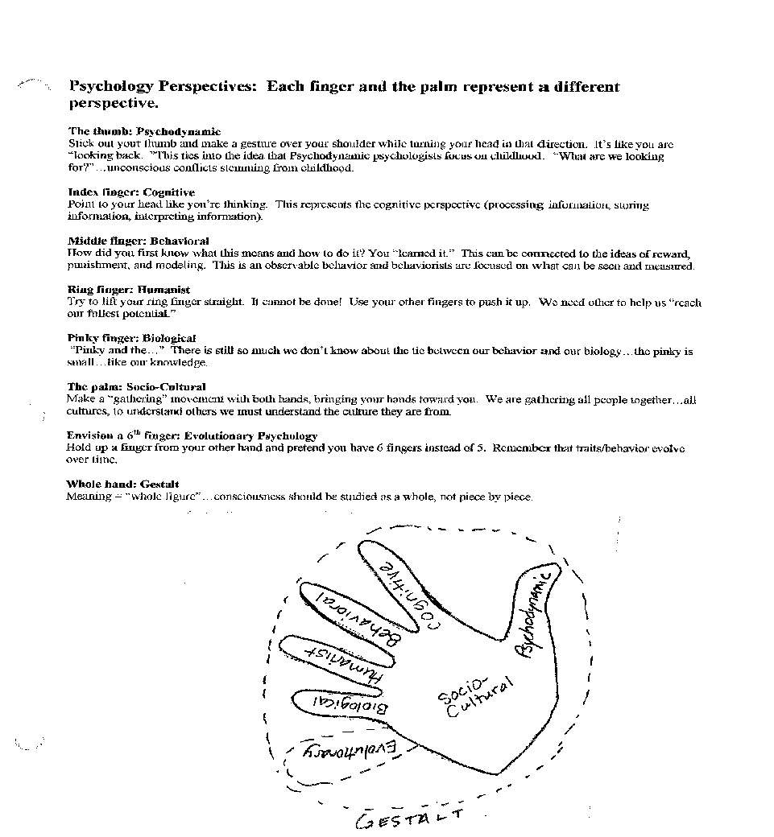
History & Approaches = 2-4%
Birth date = 1879
Wundt established 1st research lab in Germany
Transition of psychology from a philosophy to a science
Remember the hand!

Slide 4
Research Methods = 8-10%
Surveys
Longitudinal Studies
Naturalistic Observation
Case Studies
Correlational Studies
Experiments
Ethics=
No Coercion- must be voluntary
Informed consent
Anonymity
Prevent negative long-term effects
No significant risk
Must debrief

Slide 5
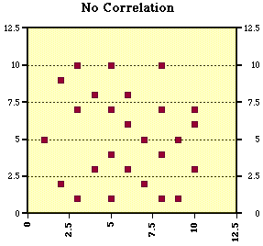
Scatterplots—use when looking for correlation
Relation is always represented by r =

Slide 6
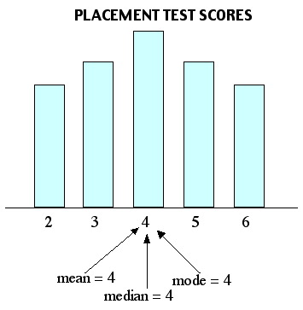
Measures of Central Tendency
Mean – average
Median – halfway point
Mode – occurs most frequently

Slide 7
Confusing Pairs
Independent Variable (What is tested) v. Dependent Variable (What is measured)
Experimental Group (is tested and/or receives a treatment) v. Control Group (Is compared to the experimental group & receives a placebo in a drug experiment)

Slide 8
Cognition = 8-10%
Thinking
Memory
Concepts –Categories -Prototypes
Heuristics
Availability
Anchoring
Confirmation Bias
Functional Fixedness
Encoding, storage, retrieval
Types = episodic, semantic, procedural
Short term (7 +/-2)
Long term (limitless)
Retrieval (recall, recognize, context, state or mood dependent)
Memory construction

Slide 9
Confusing Pairs
Assimilation (all four legged animals are “doggies”) v. Accommodation (“doggies” are different than “kitties”)
Algorithms (step-by-step) v. Heuristics (rule-of-thumb)
Primacy effect (first items remembered) v. Recency effect (last items remembered)
Proactive interference (loss of the new info) v. Retroactive interference (loss of the old info)
Implicit memory (non-declarative—doesn’t require conscious thought; skills) v. Explicit memory (declarative (requires conscious thought; facts)
Recall memory (no cues; fill in the blank) v. Recognition (some hints; multiple choice)

Slide 10
Developmental Psych = 7-9%
Prenatal (germinal, embryonic, fetal)
Infancy (reflexes, recognition, preferences)
Freud’s psychosexual stages of development (see slide)
Piaget’s stages of cognitive development (see slide)
Kholberg’s stages of moral development (see slide)
Erikson’s stages of social development (see slide)
Language development

Slide 11
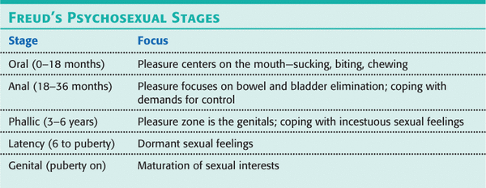

Slide 12
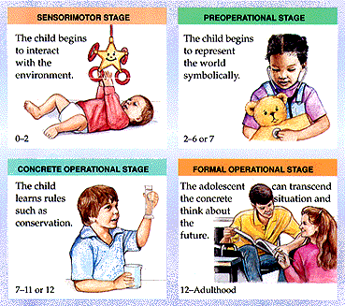

Slide 13
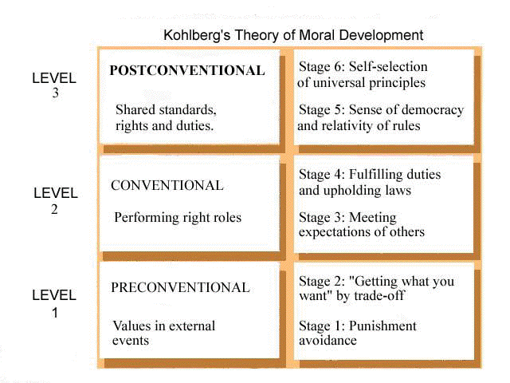

Slide 14
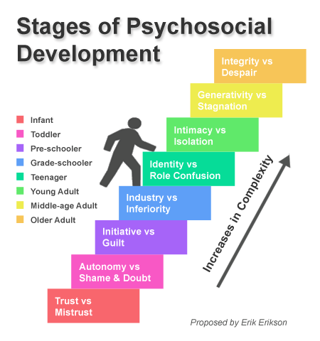

Slide 15
Confusing Pairs
Concrete operations (logical thinking) v. Formal operations (philosophical thinking)
Identical twins (same fertilized egg) v. Fraternal twins (two separate eggs)
Assimilation (all four legged animals are “doggies”) v. Accommodation (“doggies” are different than “kitties”)
Phonemes (basic sound units) v. Morphemes (basic units of meaning)

Slide 16
Biological Basis of Behavior = 8-10%
Parts of the brain & key role!
https://www.youtube.com/watch?v=vYwOtTMUz0c
Nervous system (voluntary v. involuntary)
Neurotransmitters (chemicals released by brain—see chart)
Hormones (chemicals released by endocrine system)

Slide 17
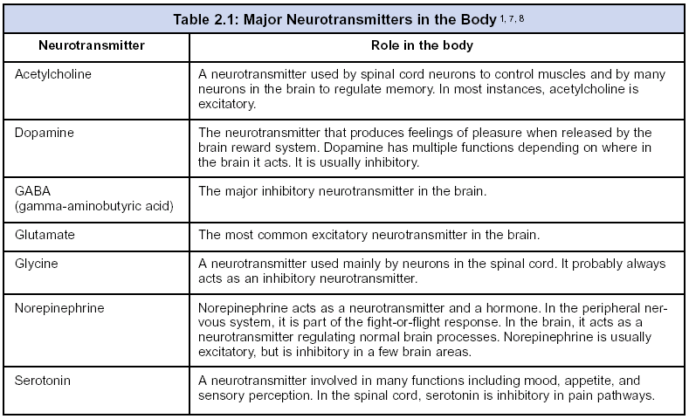

Slide 18
Confusing Pairs
Left brain (language and logic) v. Right brain (creative and spatial)
Corpus Callosum (divides the brain) v. Cerebral Cortex (cover the brain)
Sympathetic Nervous System (fight or flight) v. Parasympathetic (calming-parachute)
lateral hypothalamus (stimulates hunger) v. ventromedial hypothalamus (suppresses hunger)
Broca’s Area (makes words) v. Wernicke’s Area (comprehends words)
Afferent neurons (sensory, body to brain = “approach”) v. Efferent neurons ( motor, “exit” brain to body)

Slide 19
Sensation & Perception
Sensation
Perception
Basic sensory processes
Accessories = gather
Transduction = turn info into neural activity
Thalamus = switchboard
Common disorders (visual & hearing impairments)
Absolute threshold = minimum stimulus that can be detected 50% of the time
Difference threshold (JND) aka Weber’s Law= the smallest difference between stimuli that we can detect
Gestalt principles (see chart)

Slide 20
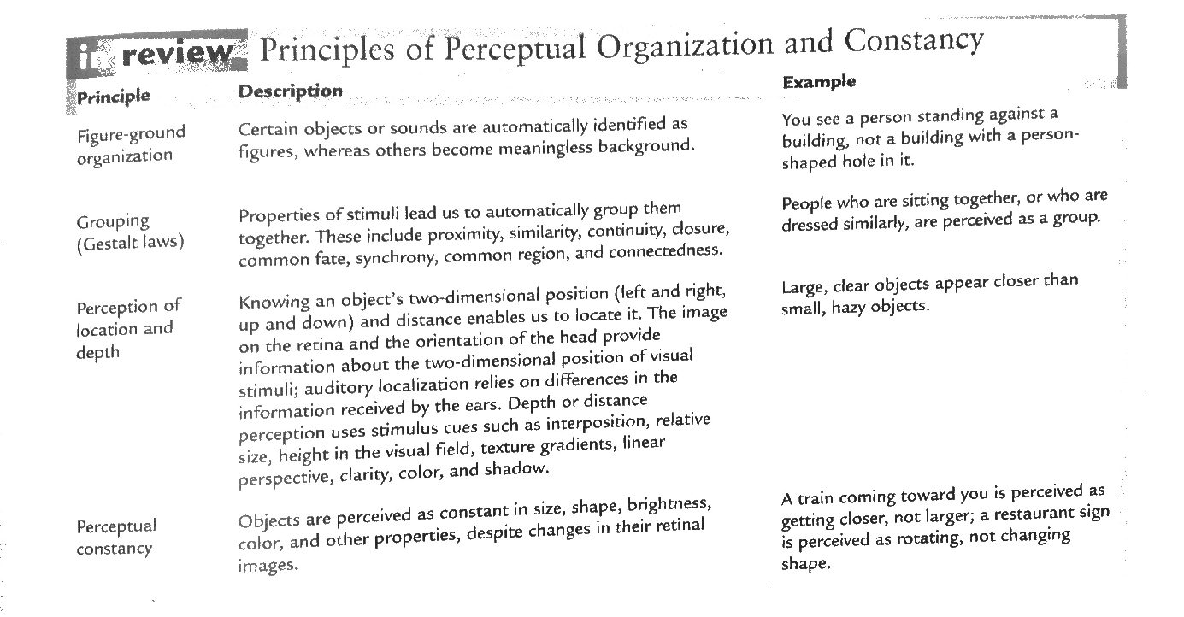

Slide 21
Learning = 7-9%
Classical Conditioning (UCS + UCR + CS = CR)
Operant Conditioning (shaping using reinforces and punishers)
Positives and negatives
Reinforcement schedules (fixed & variable intervals, ratios)
Types of learning
Cognitive = mental processes
Insight = sudden awareness
Observational = modeling
Latent = not portrayed at time of learning

Slide 22
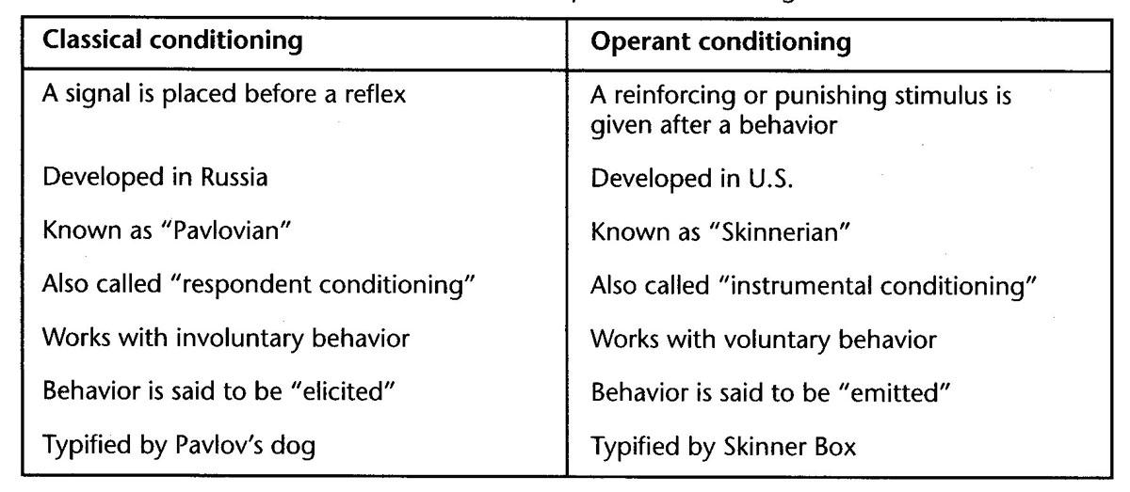
Confusing Pairs
Classical conditioning (involuntary) v. operant conditioning (voluntary)

Slide 23
States of Consciousness = 2-4%
Psychoactive drugs (categories & effects—see chart)
Stages of sleep (see slide)
Dream theories
Psychoanalytic—satisfy urges, repress desires,
Activation-Synthesis—cerebral cortex synthesizes and tries to make sense
Cognitive—review & address problems

Slide 24
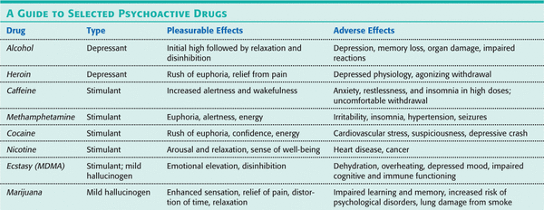

Slide 25
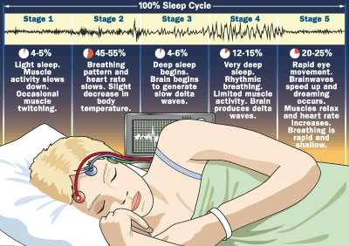
Stages of Sleep

Slide 26
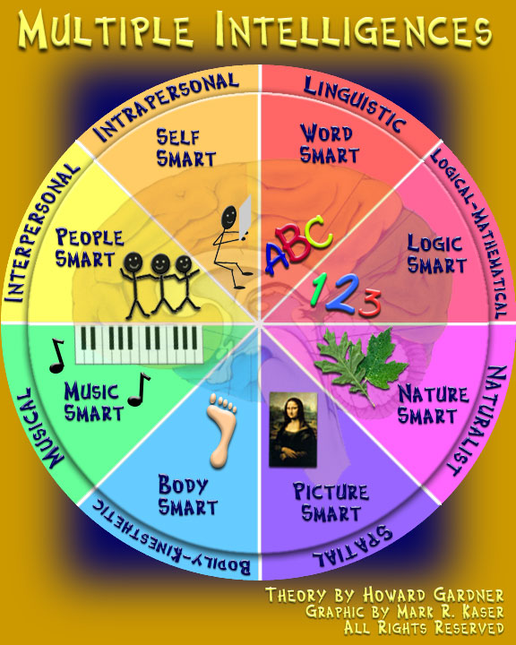
Testing and Individual Differences = 5-7%
Nature v Nurture
Assessing intelligence—types of tests, standardization, norms, etc.
Binet = dev first type intended for school children
Weschler = various age levels
Gardner’s multiple intelligences
Diversity in intelligence

Slide 27
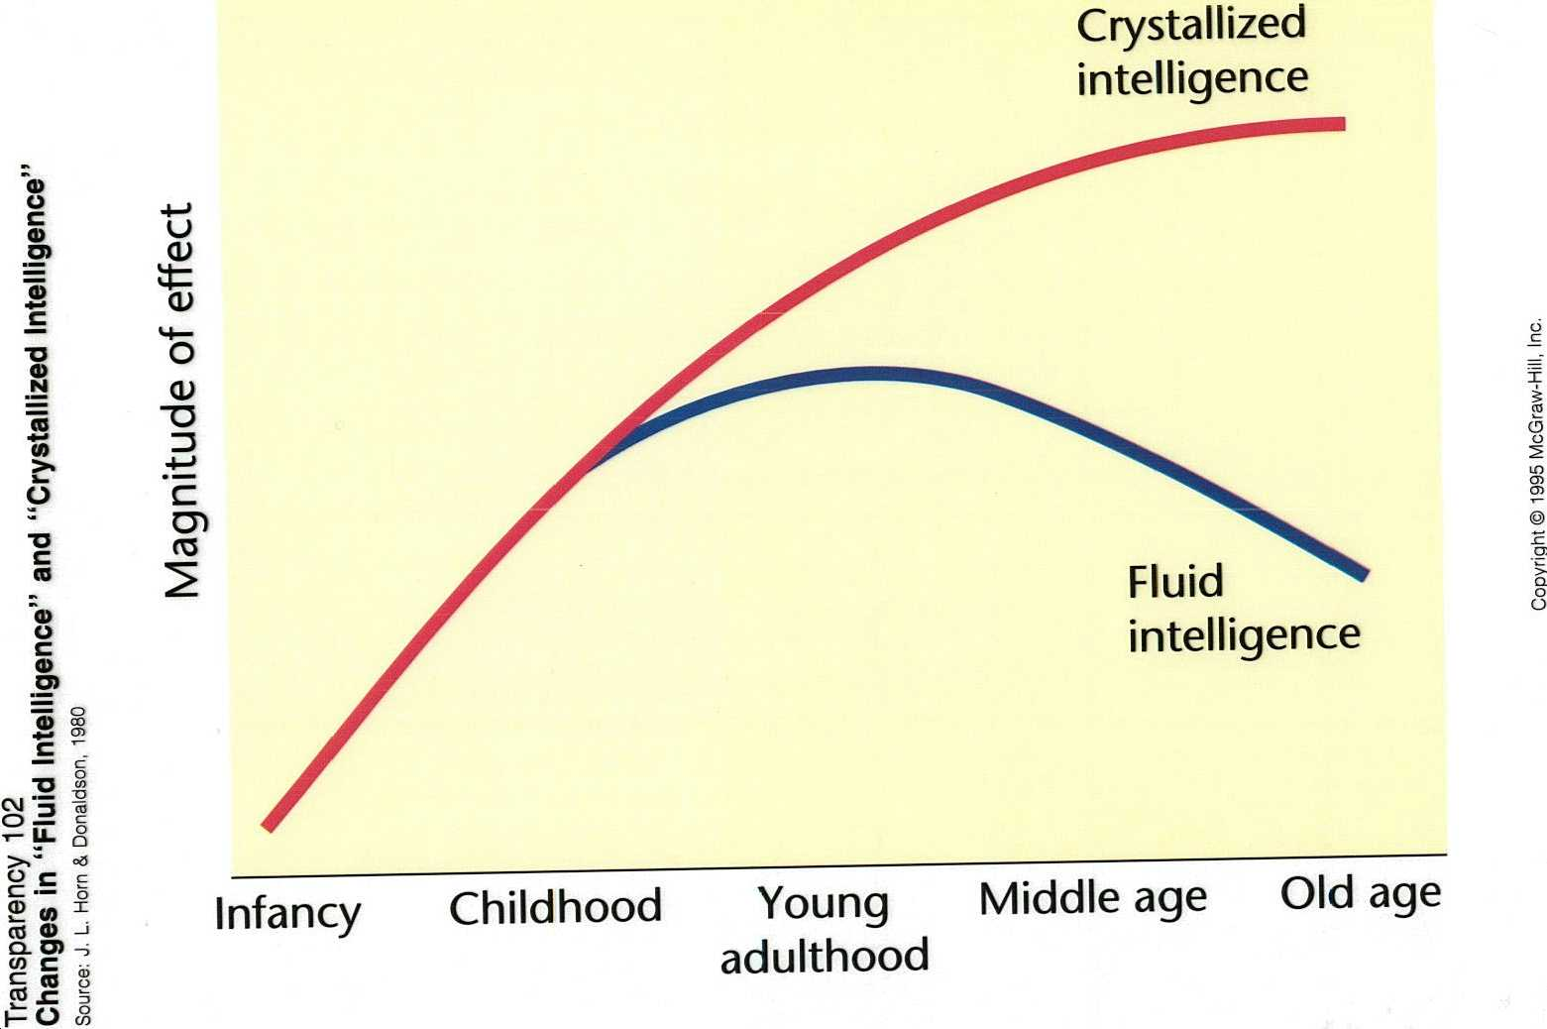
Confusing Pairs
Fluid Intelligence (processing speed) v. Crystallized Intelligence (acquired knowledge)
Validity (test measures what is should) v. Reliability (similar scores on a retest)
Achievement test (what you’ve learned) v. Aptitude test (potential)

Slide 28
Motivation & Emotion = 6-8%
Theories on Motivation
Theories on Emotion
Instinct = innate
Drive Reduction = homeostasis
Arousal = Yerkes-Dodson Law (see next slide)
Maslow’s Hierarchy of needs (see next slide)
James Lange
Cannon-Bard
Schachter-Singer
See slide!

Slide 29
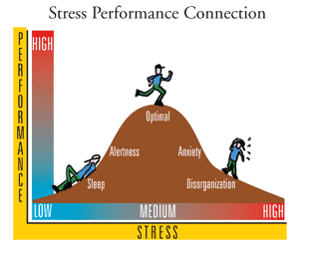
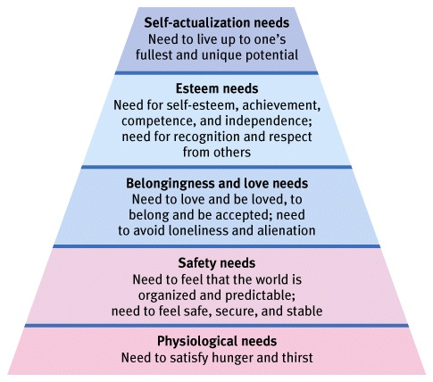
Yerkes-Dodson Law

Slide 30
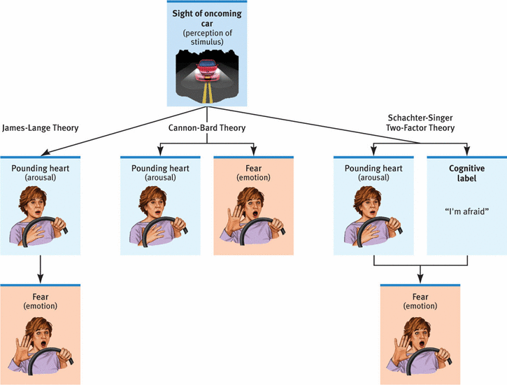

Slide 31
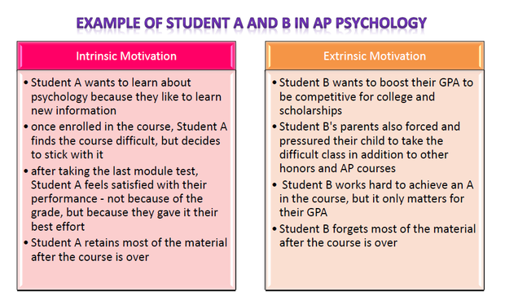
Confusing Pairs
Intrinsic motivation (for personal satisfaction) v. Extrinsic (for rewards)

Slide 32
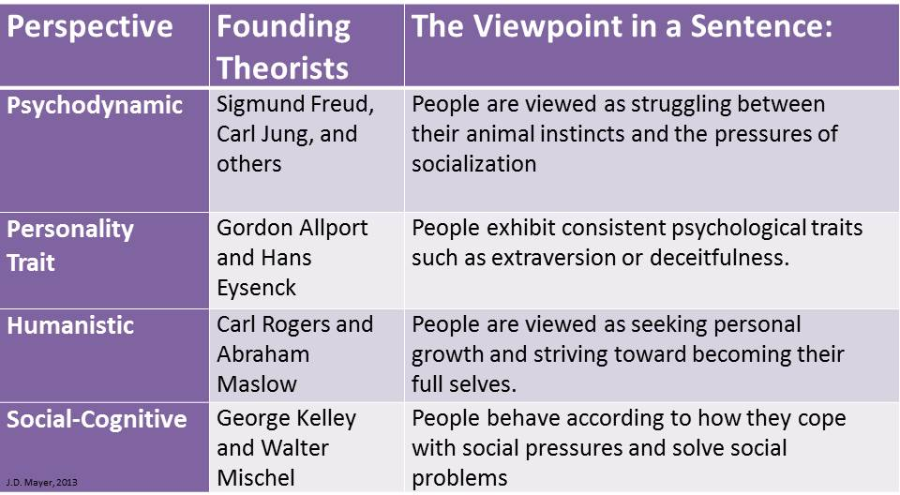
Personality = 5-7 %
Theories
Types
A (high stress) v. B (low stress)
Introvert v Extrovert & Stable v Unstable
Big 5 Factors (See next slide)

Slide 33
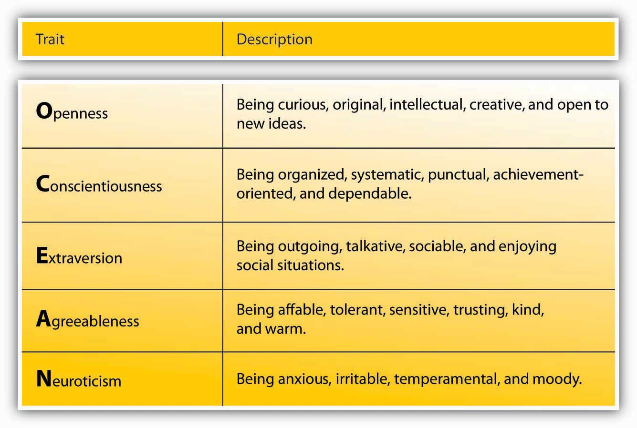

Slide 34
Abnormal Behavior = 7-9%
Psychological Disorders (see next slide and chart on page 598)
DSM-V ( Diagnostic and Statistical Manual of Mental Disorders) = the standard classification of mental disorders used by mental health professionals

Slide 35
Psych Disorders
Anxiety Disorders
Phobia = intense/irrational fear
GAD = not focused on particular situation
Panic = recurring attacks w/o warning
OCD = persistent thoughts of contamination or harm
Somatoform= no physical cause
Conversion = sensory or motor failure (ex: blindness)
Hypochondriasis = fear of illness
Somatization = numerous vague physical complaints
Pain = severe pain

Slide 36
Psych Disorders
Dissociative
Fugue = move & new identity
Amnesia = forgets personal info
DID = more than one identity
Mood
Major depressive = sad/hopeless long per of time
Dysthymic = less intense, but long per time
Bipolar = depression & mania
I – more severe
II – major depression with hypomania (less severe)
Cyclothymia – prolonged, but less severe spikes of mania and depression

Slide 37
Psych Disorders
Schizophrenia Spectrum And Other Psychotic Disorders (2 of 5 symptoms are required for diagnosis--one must be from top 3 in list)
delusions
hallucinations
disorganized speech
disorganized or catatonic behavior
negative symptoms
According to NAMI, research suggests that schizophrenia may have several possible causes:
Genetics
Environment
Brain chemistry
Substance use

Slide 38
Treatment of Abnormal Behavior = 5-7%
Types of Therapy
Psychoactive Drugs (chart on 680)
Psychotherapy (Freudian)
Classical = focus on unconscious conflicts
Contemporary = attention on unconscious AND conscious conflicts
Humanistic = people can consciously control own actions
Behavior Therapy = take action to learn new behaviors
Cognitive-Behavior = change the way one thinks
Neuroleptics = antipsychotics
Antidepressants
Lithium & anticonvulsants = mood stabilizer
Anxiolytics = anti-anxiety

Slide 39
Social Psychology = 8-10%
Social Cognition
Social Influences
Attribution theory = process to explain causes of behavior
Fundamental attribution error (other’s behavior = internal)
Actor-observer bias (own behavior = external)
Self-serving bias (success = internal, failure = external)
Stereotypes (belief), prejudice (attitude), discrimination (action)
Cognitive dissonance = want thoughts, beliefs, attitudes consistent with behavior
Conformity (Solomon Asch-length of lines experiment)
Compliance (foot in door/door in face)
Obedience (Stanley Milgram-shocks)
Group behavior
Deindividuation
Groupthink
Bystander effect (diffusion of responsibility)
Social facilitation/impairment

Slide 40
The End!

